Slide 1
Secure Data Hiding In Images Using Steganography
CAPSTONE PROJECT
Presented By: Aniket Tombare
Student Name : Aniket Tombare
College Name : Maratha Mandal Polytechnic, Belgaum
Department : Electronics and Communication Engineering

Slide 2
OUTLINE
Problem Statement
Technology used
Wow factor
End users
Result
Conclusion
Git-hub Link
Future scope

Slide 3
Problem Statement
Common encryption methods are easy to spot and might cause suspicion.
A safe way is needed to hide secret messages inside images.
Keeping data secure while making sure the image stays the same.
Creating a simple tool so anyone, even without technical skills, can use encryption and decryption.

Slide 4
Technology used
Programming Language used: Python
Image Processing Library: OpenCV
File Handling & Security: Basic encryption logic for password protection
Platform: Windows 11

Slide 5
Wow factors
Uses steganography to embed a message into an image without noticeable changes.
Lossless data hiding using pixel value manipulation instead of traditional cryptographic techniques.
LSB-Based Steganography – Hides data in the Least Significant Bit, ensuring security without visible image changes.
This is an Efficient technique for data hiding.

Slide 6
End users
Cybersecurity Enthusiasts – Exploring secure communication techniques.
Government & Defence Personnel – Transmitting confidential messages without raising suspicion.
Journalists & Activists – Concealing sensitive information in images to avoid surveillance.
Privacy-Conscious Individuals – Protecting personal data through hidden messaging.
Software Developers & Researchers – Learning and applying steganography concepts.
Students & Educators – Studying cryptography and secure communication methods.

Slide 7
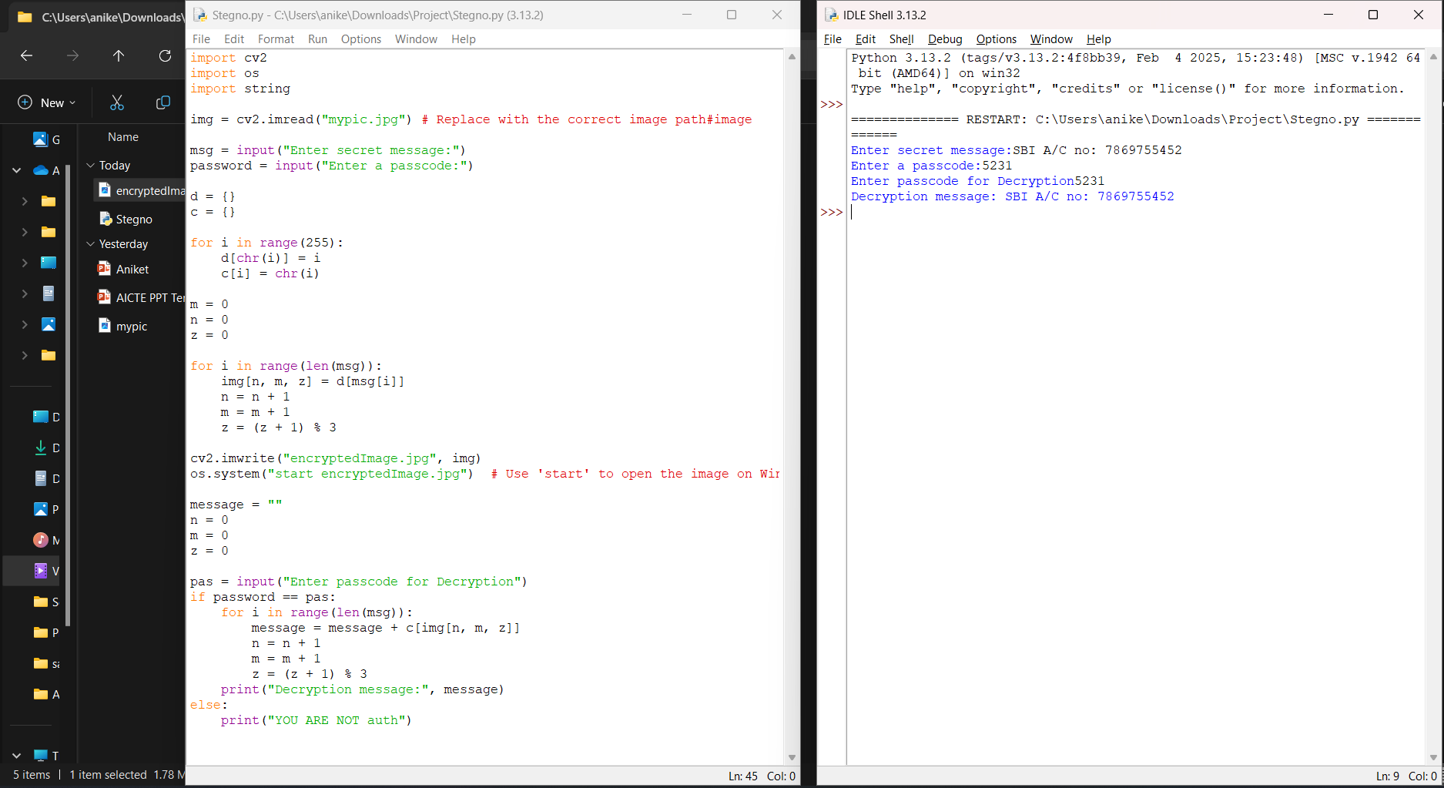


Results
Input Image
Output Image

Slide 8
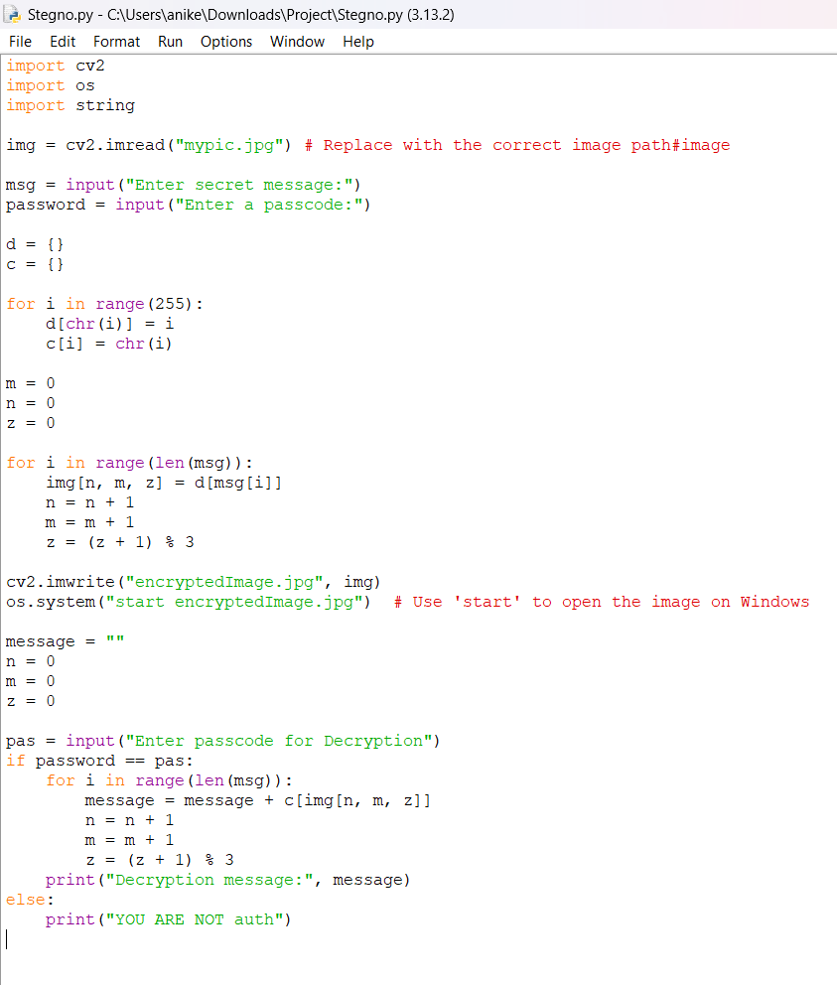

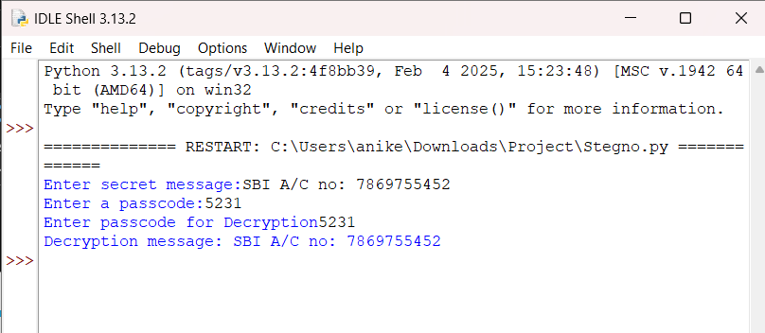
Results
Code:
Output

Slide 9
Conclusion
Successfully implemented a secure method for hiding data using steganography.
Integrated encryption and decryption for enhanced security.
Demonstrated a practical approach to secure communication through image-based message hiding.
Contributed to the field of digital privacy and secure data transmission.
Future improvements can enhance robustness, security, and scalability.

Slide 10
GitHub Link
https://github.com/Aniket073/AICTE-STEGNOGRAPHY-PROJECT.git

Slide 11
Future scope(optional)
Advanced Encryption Techniques – Use AES encryption before embedding text in images for added security.
Support for Audio & Video Steganography – Expand the technique beyond images to include audio and video files.
AI-Based Detection Prevention – Implement methods to prevent detection by modern forensic tools.
Mobile App & Web Version – Develop mobile and web-based platforms for wider accessibility.
Multi-Layer Security – Combine steganography with blockchain for ultra-secure communication.

Slide 12
THANK YOU

